Slide 1
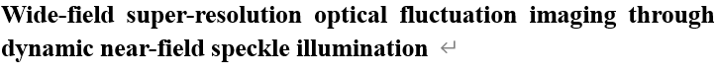
Figures for
Figure typeface : helvetica
Slide dimension adjusted to fit A4

Slide 2
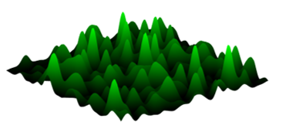
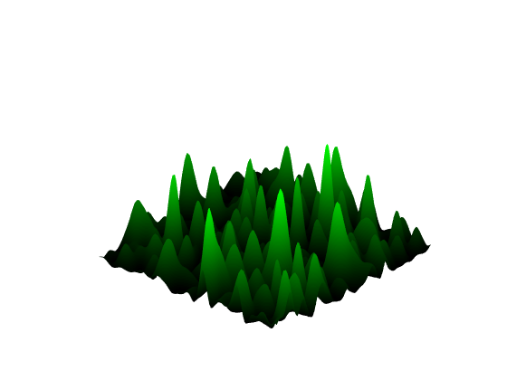
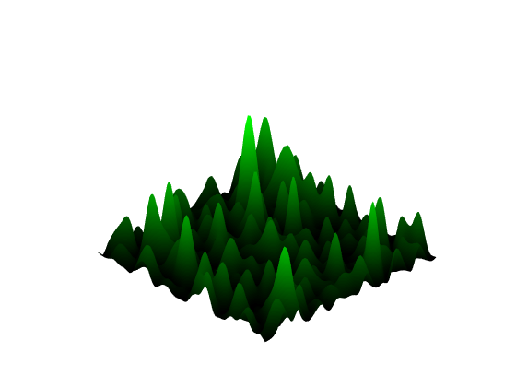
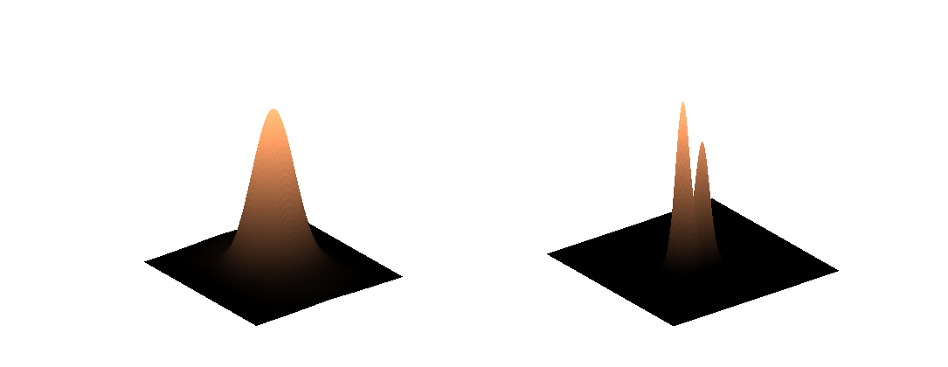

$$d<\frac{λ}{2NA}$$

Slide 3
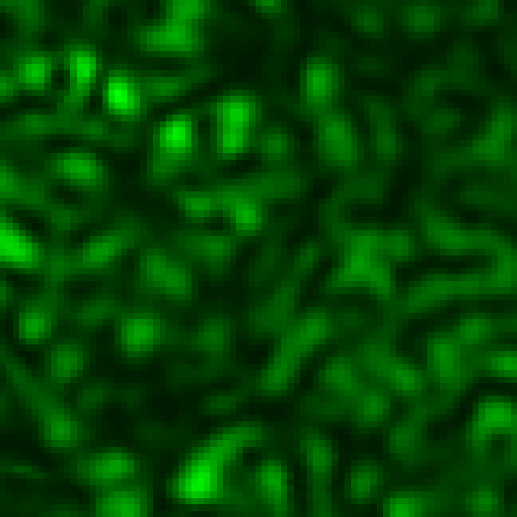
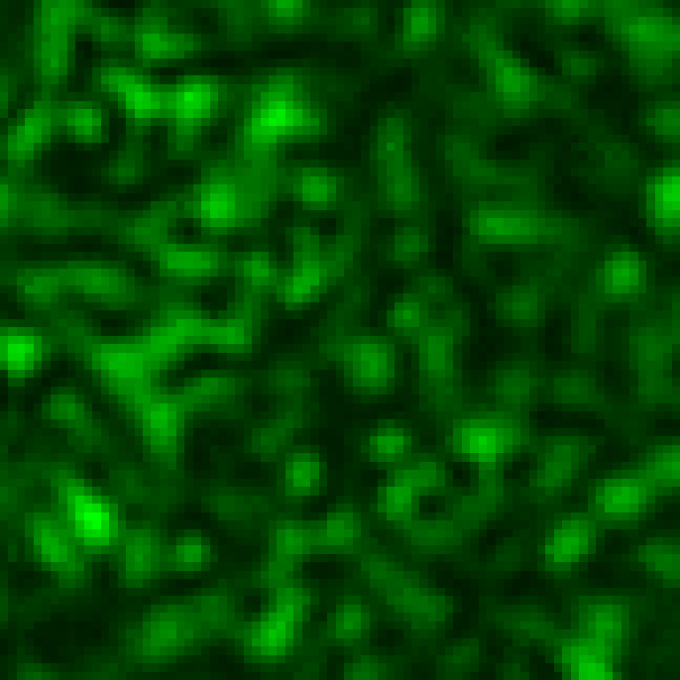
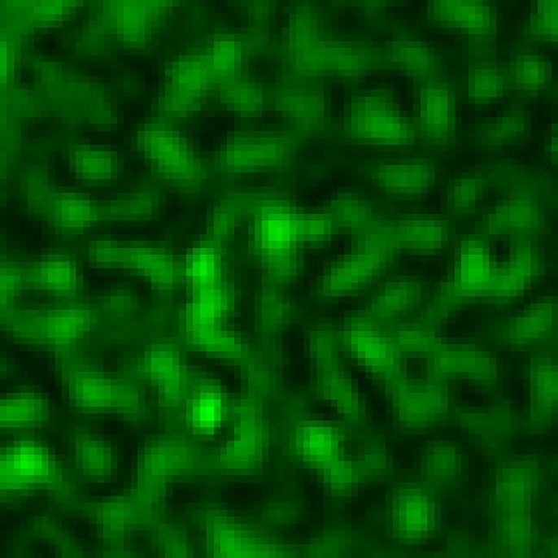
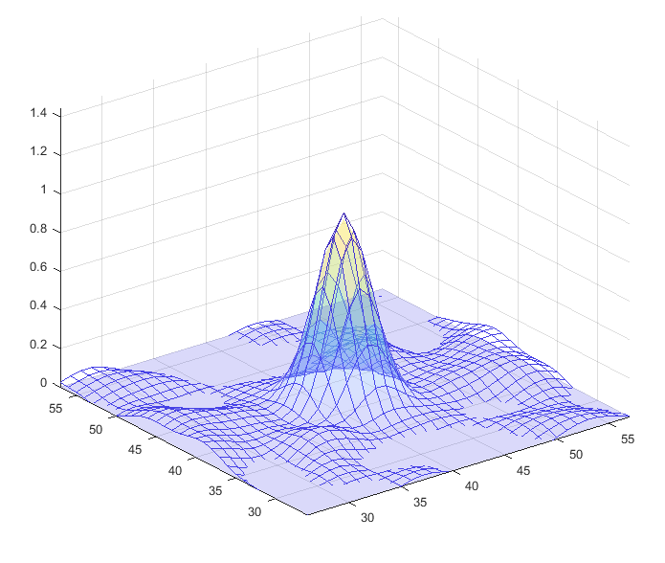
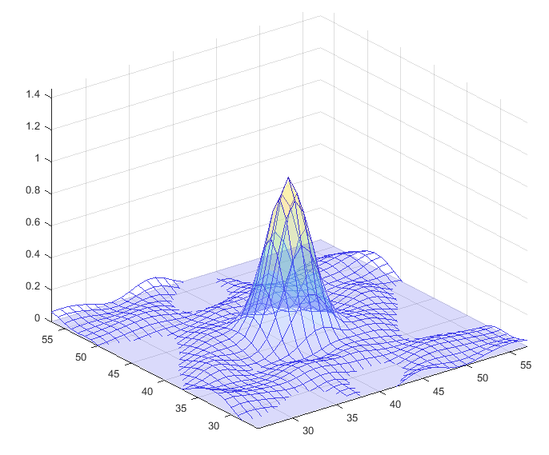
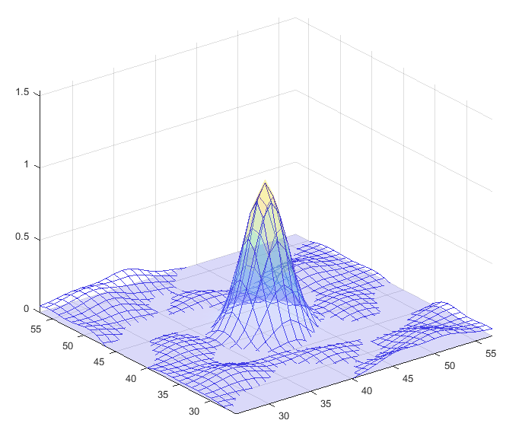
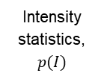
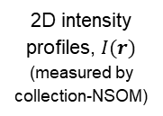

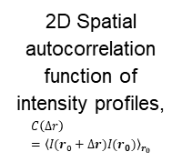
Observables
Near-field
speckle #1
Near-field
speckle #2
Near-field
speckle #3
2D intensity profiles, $I(r)$
(measured by collection-NSOM)
1 um
1 um
1 um
1000
1000
1000
Intensity statistics,
$$p(I)$$
Photon counts
Photon counts
Photon counts
500
500
500
0
0
5
10
15
20
25
0
0
5
10
15
20
25
0
0
5
10
15
20
25
Frequency
Frequency
Frequency
2D Spatial autocorrelation function of intensity profiles,
$$C\left(Δr\right)={\left\langle I(r_{0}+Δr)I(r_{0})\right\rangle }_{r_{0}}$$
Speckle grain size
(Gaussian fitted FWHM of autocorrelation function $C\left(Δr\right)$)
154.6 nm
149.4 nm
141.9 nm

Slide 4


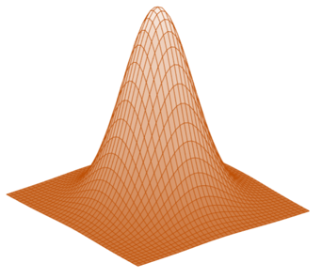
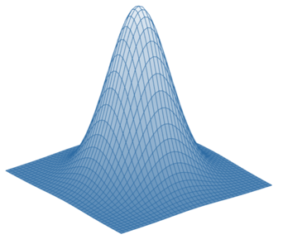
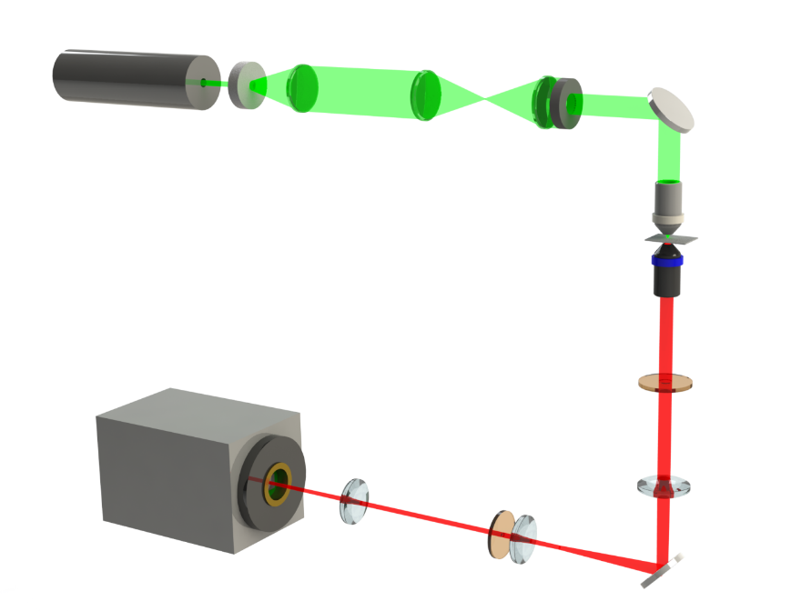

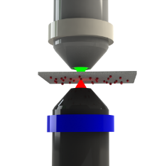


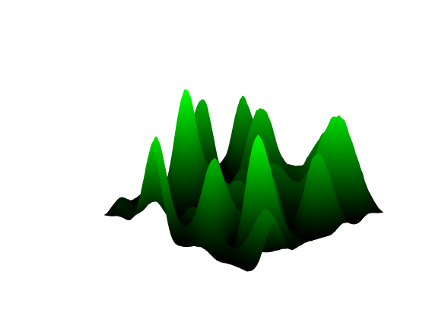
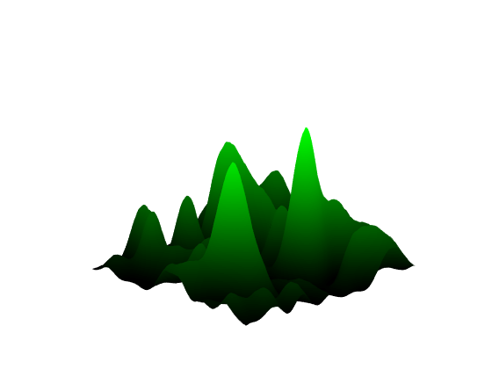
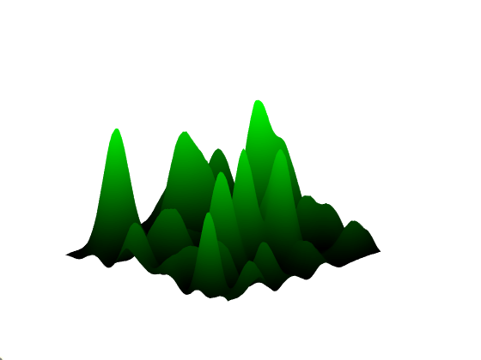


































a
$$d$$
$$I(r,t)$$
Diffraction-limited (unresolved)
$$t$$
$$FS(r,t+Δt)$$
(Left emitter)
$$FS(r,t)$$
(Mid-point) Spurious correlation
SOFI
a
$$r$$
532 nm laser
Translated diffuser
Lens
Dynamic far-field
speckle illumination
(Right emitter)
Mirror
Unresolved
Speckle pattern
$$t$$
Illumination
Illumination objective
b
$$d$$
Turbid medium
Objective
lens
$$I(r,t)$$
Diffraction-limited (unresolved)
Sample
$$t$$
Detection
Detection objective
Signal
Filter
$$NS(r,t+Δt)$$
(Left emitter)
Lens
Lens
$$NS(r,t)$$
EMCCD
(Mid-point) Reduced correlation
SOFI
Filter
$$r$$
Mirror
Dynamic near-field
speckle illumination
(Right emitter)
Super-resolved
$$t$$
c
d
Translated diffuser
$$Δx$$
$$x$$
Time
$$x$$
$$x$$
z
$${x=x}_{0}$$
$${x=x}_{0}+Δx$$
$${x=x}_{0}+2Δx$$
z
Translated diffuser
$$L1$$
$$Δx$$
$$2Δx$$
$$FS(r,x)$$
Far-field speckles $[FS(r,x)$]
$$FS(r,x_{0})$$
$$FS(r,x_{0}+Δx)$$
$$FS(r,x_{0}+2Δx)$$
$$L2$$
Sample plane
Disordered medium
Disordered medium
Near-field speckles
$[NS(r,x)$]
$$NS(r,x)$$
$$NS(r,x_{0})$$
$$NS(r,x_{0}+Δx)$$
$$NS(r,x_{0}+2Δx)$$
Fluorophores
Two fluctuated fluorophores

Slide 5



















a
532 nm laser
Translated diffuser
Lens
b
Translated diffuser
Mirror
$$Δx$$
$$x$$
$$x$$
Illumination
Speckle pattern
z
Turbid medium
Illumination objective
Objective
lens
$$L1$$
Sample
$$FS(r,x)$$
Detection
Detection objective
Signal
$$L2$$
Filter
Lens
Lens
Turbid medium
EMCCD
Filter
$$NS(r,x)$$
c
Mirror
Fluorophores
$$x$$
Time
z
$${x=x}_{0}$$
$${x=x}_{0}+Δx$$
$${x=x}_{0}+2Δx$$
Translated diffuser
$$FS(r,x_{0})$$
$$Δx$$
$$2Δx$$
Far-field speckles $[FS(r,x)$]
$$FS(r,x_{0}+Δx)$$
$$FS(r,x_{0}+2Δx)$$
Turbid medium
Sample plane
Near-field speckles
$[NS(r,x)$]
$$NS(r,x_{0})$$
$$NS(r,x_{0}+Δx)$$
$$NS(r,x_{0}+2Δx)$$
Two fluctuated fluorophores
Fig. 2 Dynamic near-field speckle illumination for NS-SOFI imaging experiment. a Experimental setup with sample-mounting configuration for NS-SOFI imaging experiment. b Schmatic representation of illumination optics in a to produce dynamic near-field speckle illumination. A pair of red and blue sphere describes two independent fluorophores separated within subdiffraction distance under dynamic near-field speckle illumination. c Pictorial description of two-step scattering of a laser beam through the translated diffuser and turbid medium, which results in dynamic near-field speckle illumination at the sample plane.

Slide 6


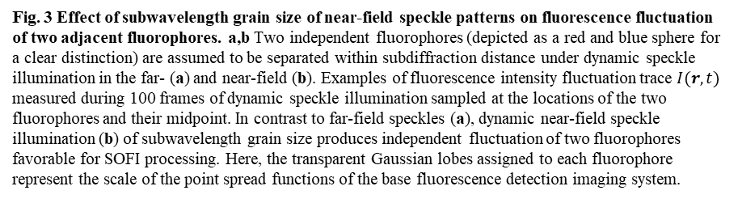
a
: Two independent fluorophores separated within subdiffraction distance
Far-field
speckle illumination
$$I(r,t)$$
Spurious correlation
Time
b
Near-field
speckle illumination
$$I(r,t)$$
Vanishing correlation
Time
Fig. 3 Effect of subwavelength grain size of near-field speckle patterns on fluorescence fluctuation of two adjacent fluorophores. a,b Two independent fluorophores (depicted as a red and blue sphere for a clear distinction) are assumed to be separated within subdiffraction distance under dynamic speckle illumination in the far- (a) and near-field (b). Examples of fluorescence intensity fluctuation trace $I(r,t)$ measured during 100 frames of dynamic speckle illumination sampled at the locations of the two fluorophores and their midpoint. In contrast to far-field speckles (a), dynamic near-field speckle illumination (b) of subwavelength grain size produces independent fluctuation of two fluorophores favorable for SOFI processing. Here, the transparent Gaussian lobes assigned to each fluorophore represent the scale of the point spread functions of the base fluorescence detection imaging system.

Slide 7
a
: Two independent fluorophores separated within subdiffraction distance
Far-field
speckle illumination
$$I(r,t)$$
Spurious correlation
Time
b
Near-field
speckle illumination
$$I(r,t)$$
Vanishing correlation
Time

Slide 8
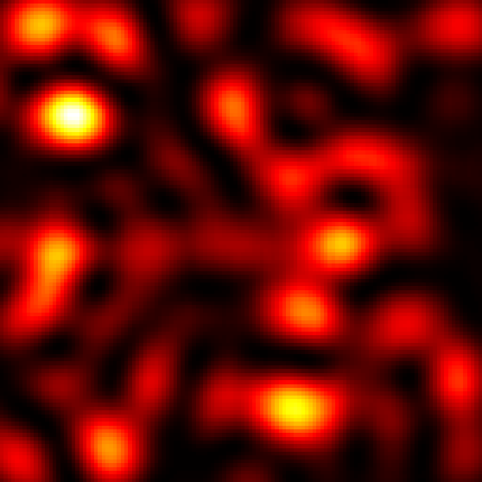
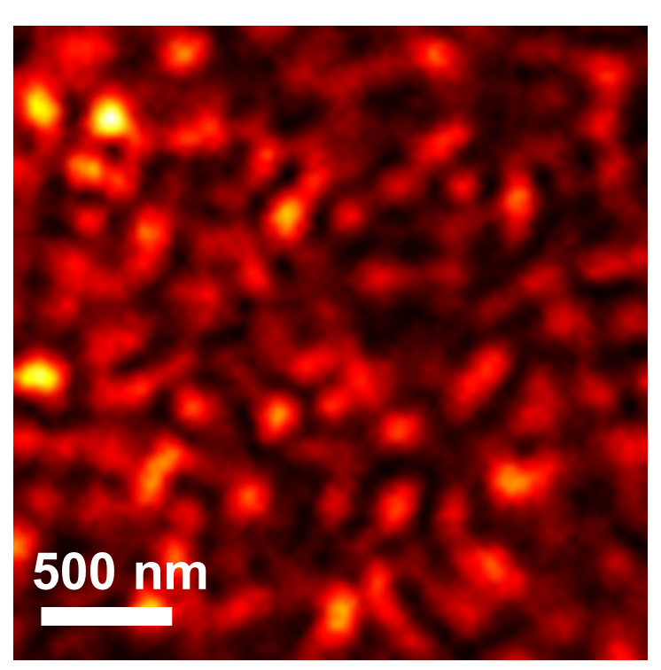
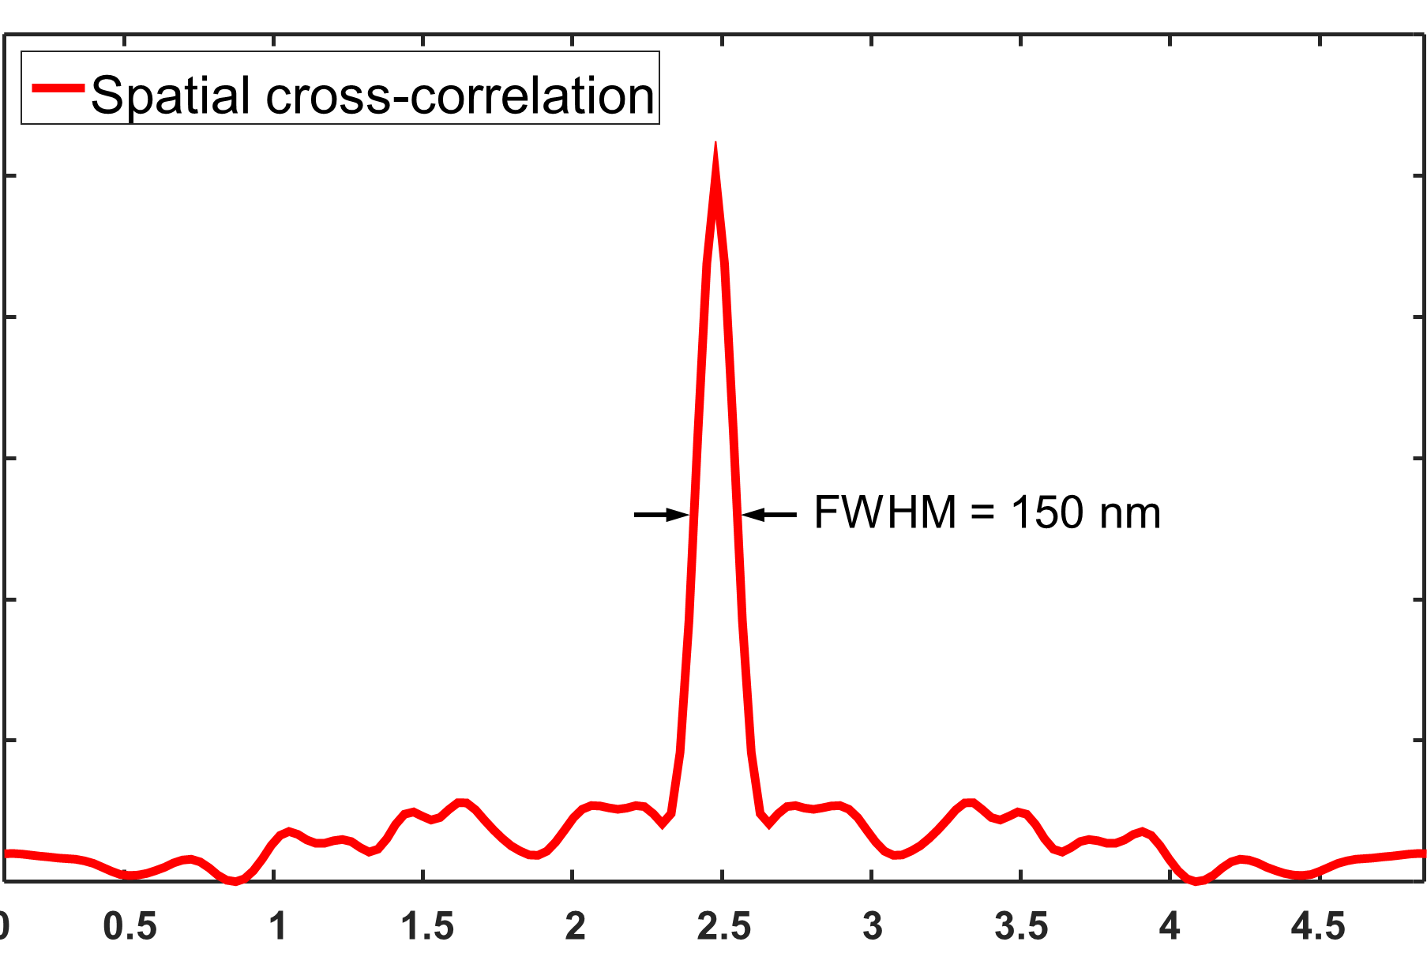
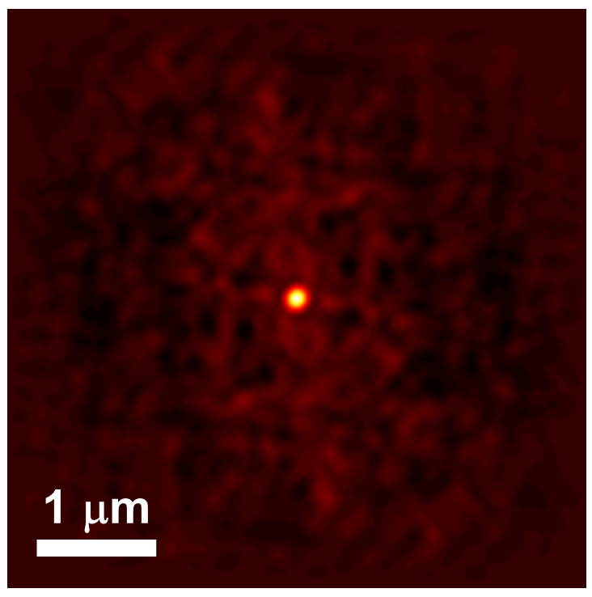
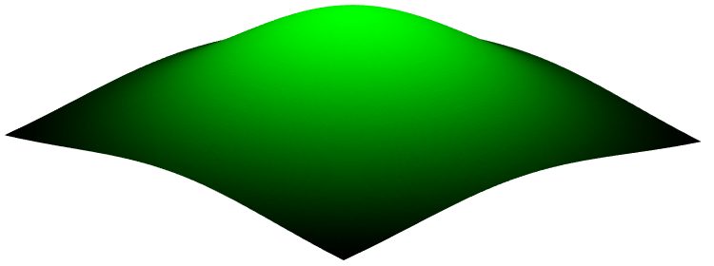
a
Far-field speckle pattern
b
c
z >> λ
500 nm
Near-field speckle pattern
z < λ
0
1
d
1.2
1.0
z
0.8
Normalized Intensity (a.u.)
y
Turbid medium
0.6
FWHM = 150 nm
x
Incident Laser beam
0.4
0.2
0
-2.0
-1.5
-1.0
-0.5
0
0.5
1.0
1.5
2.0
Distance (µm)
0
Fig. 1 Comparison of speckle patterns in the far- and near-field. a Diagrams comparing far-field and near-field speckle patterns. In contrast to far-field speckle patterns having propagated over a distance longer than a wavelength (z ≫ λ), near-field speckle patterns occur within a subwavelength (z < λ) of the exit surface of a turbid medium, preserving evanescent high spatial-frequency Fourier components. b,c Measured intensity profiles of speckle patterns in the far-field (b) and the near-field (c). Color bars express normalized intensity. d A cross-sectional line profile along the dashed white line in the spatial autocorrelation image (inset) of the near-field speckle pattern (c).

Slide 9
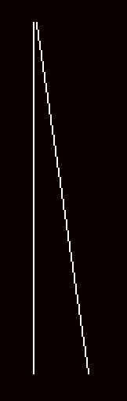
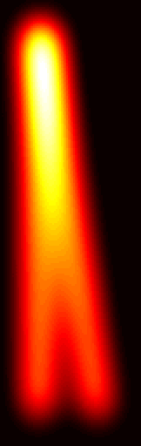
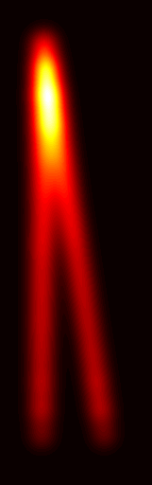
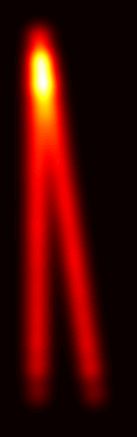
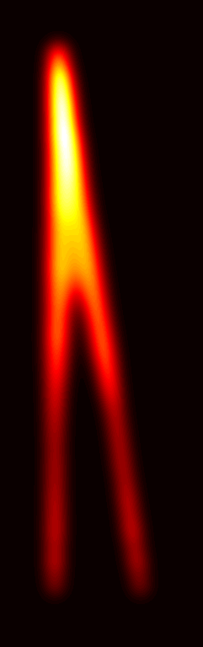
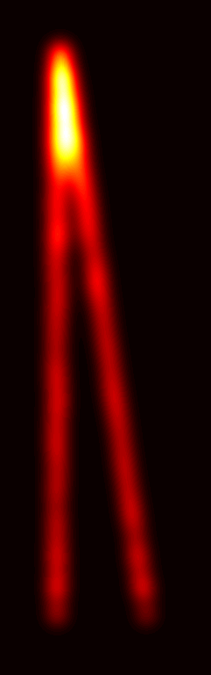
a
Object
b
Mean
c
2nd S-SOFI
2nd NS-SOFI
d
3rd S-SOFI
3rd NS-SOFI
1
e
f
0
Mean
Mean
1.2
2nd S-SOFI
1.2
3rd S-SOFI
150 nm
2nd NS-SOFI
100 nm
3rd NS-SOFI
1
1
0.8
0.8
Normalized Intensity (a.u.)
160 nm
Normalized Intensity (a.u.)
160 nm
0.6
0.6
0.4
280 nm
0.4
280 nm
0.2
0.2
0
0
-0.3
-0.2
-0.1
0
0.1
0.2
0.3
-0.3
-0.2
-0.1
0
0.1
0.2
0.3
Distance (µm)
Distance (µm)
Fig. 4 NS-SOFI resolution gain tested by computational test targets. a Two diverging filaments as the ground truth for our computational resolution test. b Mean image of the speckle-fluctuated image stack equivalent to a wide-field diffraction-limited image under uniform illumination. c The second order S-SOFI images under far-field (left, 2nd S-SOFI) and near-field (right, 2nd NS-SOFI) speckle illumination. d Third-order S-SOFI images under far-field (left, 3rd S-SOFI) and near-field (right, 3rd NS-SOFI) speckle illumination. e Cross-sectional intensity profiles along linecuts over the mean image (b), 2nd S-SOFI image (c, left), and 2nd NS-SOFI image (c, right). f Cross-sectional intensity profiles along linecuts over the mean image (b), 3rd S-SOFI image (d, left), and 3rd NS-SOFI image (d, right). Scale bars: a-d 300 nm

Slide 10
a
Object
b
Mean
c
2nd S-SOFI
2nd NS-SOFI
d
3rd S-SOFI
3rd NS-SOFI
1
e
f
0
Mean
Mean
1.2
2nd S-SOFI
1.2
3rd S-SOFI
150 nm
2nd NS-SOFI
100 nm
3rd NS-SOFI
1
1
0.8
0.8
Normalized Intensity (a.u.)
160 nm
Normalized Intensity (a.u.)
160 nm
0.6
0.6
0.4
280 nm
0.4
280 nm
0.2
0.2
0
0
-0.3
-0.2
-0.1
0
0.1
0.2
0.3
-0.3
-0.2
-0.1
0
0.1
0.2
0.3
Distance (µm)
Distance (µm)

Slide 11
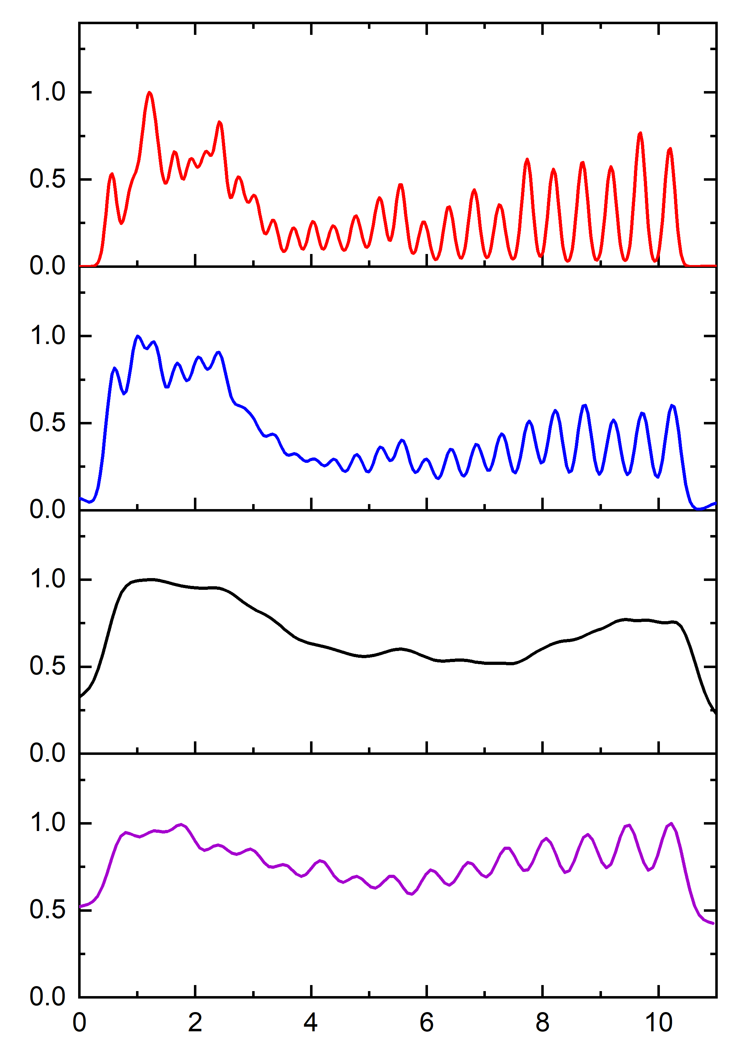
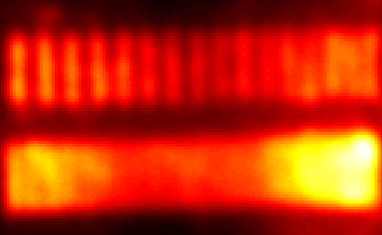
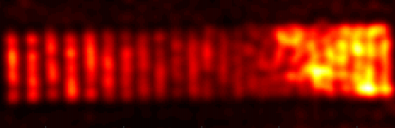
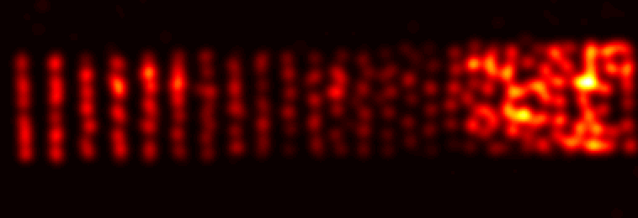
a
1
3
4
16
e
c
1.0
1
3
4
Mean (line 1-16)
3
3rd NS-SOFI (line 18-45)
315±10 nm
30
20
742±5 nm
28
27
33
17
34
44
0.5
732±40 nm
0.0
2
Mean (line 17-44)
2nd NS-SOFI (line 18-45)
SEM
375±5 nm
324±5 nm
1.0
$$\text{3}\text{63}\text{±}\text{2}\text{0 }\text{nm}$$
20
b
1
3
4
16
0.5
1
0.0
2
Mean (line 18-45)
Normalized Intensity (a.u.)
2nd NS-SOFI (line 17-44)
44
3
17
44
27
1.0
28
2
0.5
$$\text{3}\text{63}\text{±}\text{2}\text{0 }\text{nm}$$
Mean
c
28
44
Mean (line 1-17)
4
3
1
17
27
0.0
4
3rd NS-SOFI (line 17-44)
3
1.0
33
2nd NS-SOFI
315±10 nm
34
732±40 nm
d
33
0.5
17
34
44
4
0.0
0
1
2
3
4
5
6
7
8
9
10
11
Distance (µm)
3rd NS-SOFI
Distance (µm)
Fig. 5 Experimental test of resolution enhancement with NS-SOFI technique. a SEM image of a ruler pattern milled on 30 nm-thick gold layer deposited on top of a coverslip. Each line dip is labeled with fluorescent colloidal quantum dots to provide a reference length for fluorescence imaging system under test. Total of 44 lines are numbered as indicators of the individual lines. b A diffraction-limited mean image is defined as the average of a set of fluorescent images acquired under dynamic near-field speckle patterns. c,d 2nd and 3rd NS-SOFI images of the fluorescent line arrays in the second row (from line 17 to 44). e Cross-sectional intensity profiles taken over the mean (b), 2nd and 3rd NS-SOFI images (c,d). More than 20 intensity profiles are taken in parallel to the dashed lines (①-purple, ②-black, ③-blue, and ④-red) and then averaged to produce a single representative intensity profile as shown in e, from which the lateral spatial resolution of each fluorescent image is measured. Scale bars: a-d 1 μm.

Slide 12
a
1
3
4
16
e
1.0
1
3
4
Mean (line 1-16)
742±5 nm
28
27
33
17
34
44
0.5
732±40 nm
0.0
2
Mean (line 17-44)
SEM
375±5 nm
324±5 nm
1.0
b
1
3
4
16
0.5
1
0.0
Normalized Intensity (a.u.)
2nd NS-SOFI (line 17-44)
44
3
17
44
27
1.0
28
2
0.5
$$\text{3}\text{63}\text{±}\text{2}\text{0 }\text{nm}$$
Mean
c
28
44
17
27
0.0
4
3rd NS-SOFI (line 17-44)
3
1.0
33
2nd NS-SOFI
315±10 nm
34
d
33
0.5
17
34
44
4
0.0
0
1
2
3
4
5
6
7
8
9
10
11
3rd NS-SOFI
Distance (µm)

Slide 13
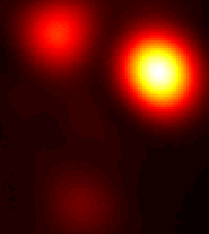
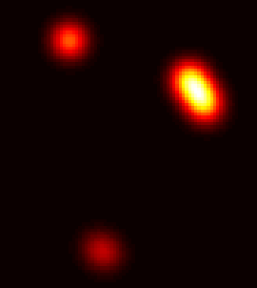
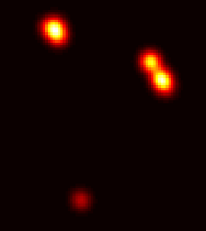
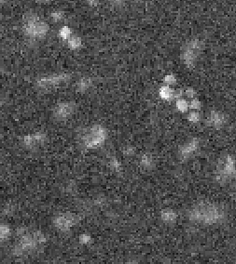
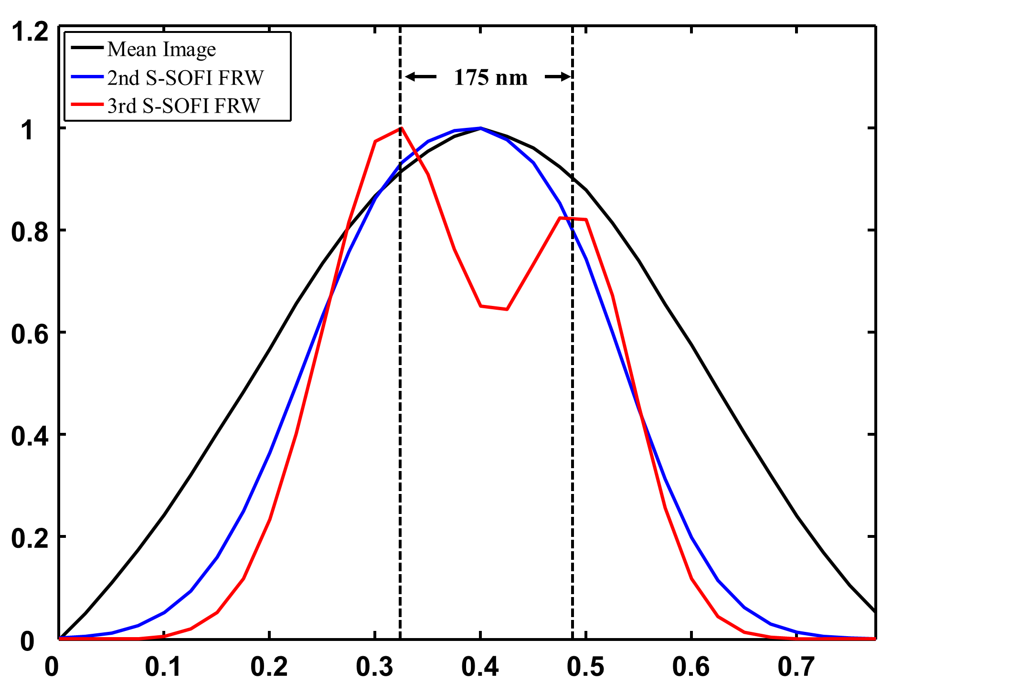
a
Mean
b
2nd NS-SOFI
c
3rd NS-SOFI
d
SEM
175 nm
e
175 nm
Mean
2nd NS-SOFI
3rd NS-SOFI
Normalized Intensity (a.u.)
-0.3
-0.2
-0.1
0
0.1
0.2
0.3
Distance (µm)
Fig. 6 Resolution enhancement with NS-SOFI technique using fluorescent beads with emission wavelengths of 560 nm. a Mean (diffraction-limited resolution), b 2nd NS-SOFI and c 3rd NS-SOFI super-resolution images of the same region of interest. Intensity profiles are taken along the dashed lines in each image to compare the resolution. d SEM image of the true location of fluorescent beads in the same field-of-view of optical images (a-c). The white arrows indicate the corresponding positions of the beads in the 3rd NS-SOFI image. e Three intensity profiles taken along the dashed lines in optical images (a-c). Fluorescent beads separated by 175 nm are resolved by third order NS-SOFI processing (solid red lines in e). Scale bars: a-d 500 nm

Slide 14
a
Mean
b
2nd NS-SOFI
c
3rd NS-SOFI
d
SEM
175 nm
e
175 nm
Mean
2nd NS-SOFI
3rd NS-SOFI
Normalized Intensity (a.u.)
-0.3
-0.2
-0.1
0
0.1
0.2
0.3
Distance (µm)

Slide 15


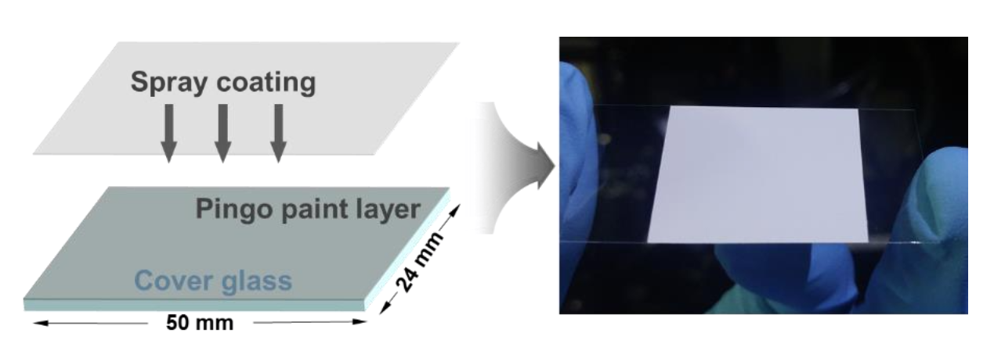

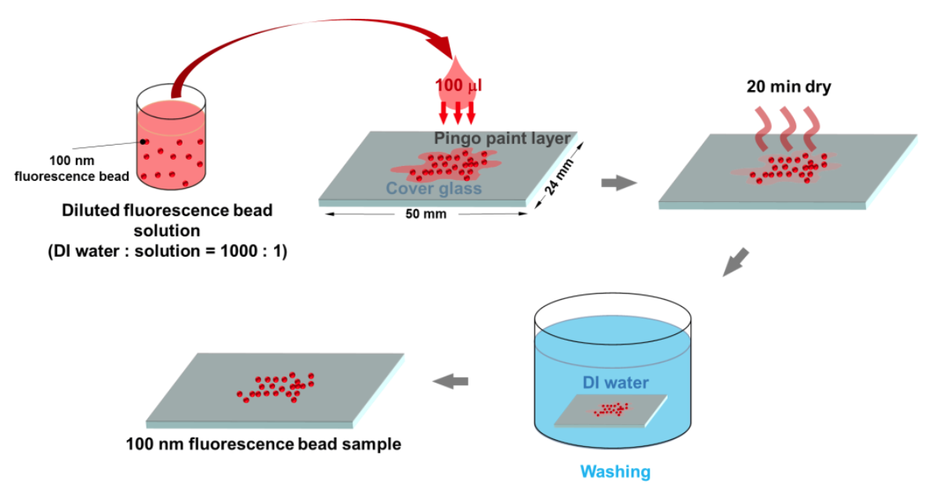

Figure S1. Sample information for figure 5, 6.
a
$$TiO_{2}$$
c
150 nm
Au
Au
Au
Au
b
30 nm Au thin film
Spray coating
a white turbid layer
35 nm
QDs
Unwanted void
CdSe quantum dots
Coverslip
Unwanted FIB dip
5 nm Cr
Coverslip
Coverslip
Coverslip
c
Line patterns as input to focused-ion beam
Pattern transferred on the Au film
Fig. S1 Schematics of sample preparation process. a Preparation of turbid media to generate near-field speckle patterns at the sample plane. Several trials of spray coating a bare coverslip with a white paint layer composed of TiO₂ nanoparticles and fixative polymer easily create a few micrometer-thick turbid medium to ensure multiple scattering of incident laser beam. b Three steps to fabricate the fluorescent length standard specimen in Fig. 5. c Dry-casting diluted fluorescent beads for the specimen in Fig. 6.

Slide 16
a
b
30 nm Au thin film
CdSe quantum dots
Spray coating
a white turbid layer
Coverslip
Coverslip
Coverslip
c

Slide 17
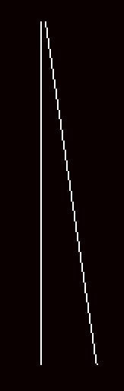
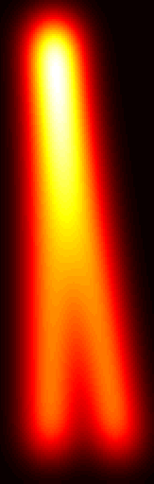
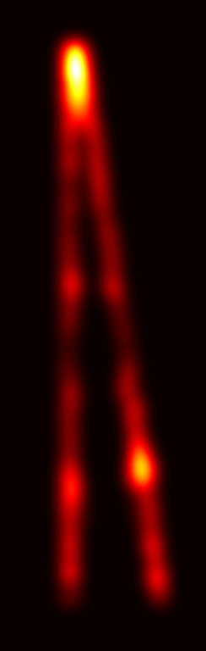



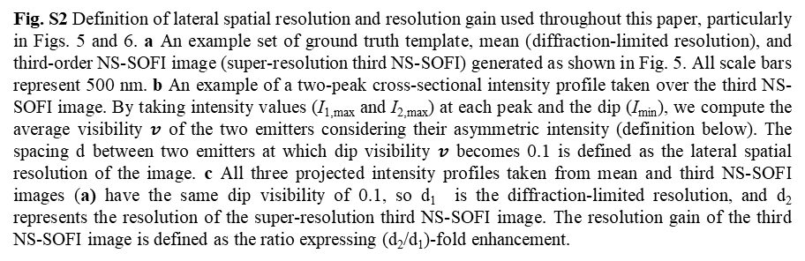



Figure S2. Lateral spatial resolution : Dip visibility
a
b
Linecut C
Truth
Mean
NS-SOFI3
$$I_{1,max}$$
$$I_{2,max}$$
FS-SOFI2
Normalized Intensity
$$I_{min}$$
$$d$$
A
C
Distance ($μm$)
$$v=\frac{\min\left(I_{1,max},I_{2,max}\right)}{\max\left(I_{1,max},I_{2,max}\right)}×\frac{1}{2}\left\{\frac{I_{1,max}−I_{min}}{I_{1,max}+I_{min}}+\frac{I_{2,max}−I_{min}}{I_{2,max}+I_{min}}\right\}$$
c
1.2
$$d_{1}$$
Linecut A
1
$$d_{2}$$
Linecut B
B
0.8
Linecut C
0.6
Normalized Intensity
0.4
0.2
0
0
0.2
0.4
0.6
0.8
1.0
0
1
Distance ($μm$)
Resolution gain = $d_{2}/d_{1}$
Fig. S2 Definition of lateral spatial resolution and resolution gain used throughout this paper, particularly in Figs. 5 and 6. a An example set of ground truth template, mean (diffraction-limited resolution), and third-order NS-SOFI image (super-resolution third NS-SOFI) generated as shown in Fig. 5. All scale bars represent 500 nm. b An example of a two-peak cross-sectional intensity profile taken over the third NS-SOFI image. By taking intensity values (I_{1,max} and I_{2,max}) at each peak and the dip (I_{min}), we compute the average visibility $v$ of the two emitters considering their asymmetric intensity (definition below). The spacing d between two emitters at which dip visibility $v$ becomes 0.1 is defined as the lateral spatial resolution of the image. c All three projected intensity profiles taken from mean and third NS-SOFI images (a) have the same dip visibility of 0.1, so d₁ is the diffraction-limited resolution, and d₂ represents the resolution of the super-resolution third NS-SOFI image. The resolution gain of the third NS-SOFI image is defined as the ratio expressing (d₂/d₁)-fold enhancement.

Slide 18
a
b
Linecut C
Truth
Mean
NS-SOFI3
$$I_{1,max}$$
$$I_{2,max}$$
FS-SOFI2
Normalized Intensity
$$I_{min}$$
$$d$$
A
C
Distance ($μm$)
c
1.2
$$d_{1}$$
Linecut A
1
$$d_{2}$$
Linecut B
B
0.8
Linecut C
0.6
Normalized Intensity
0.4
0.2
0
0
0.2
0.4
0.6
0.8
1.0
0
1
Distance ($μm$)
Resolution gain = $d_{2}/d_{1}$

Slide 19
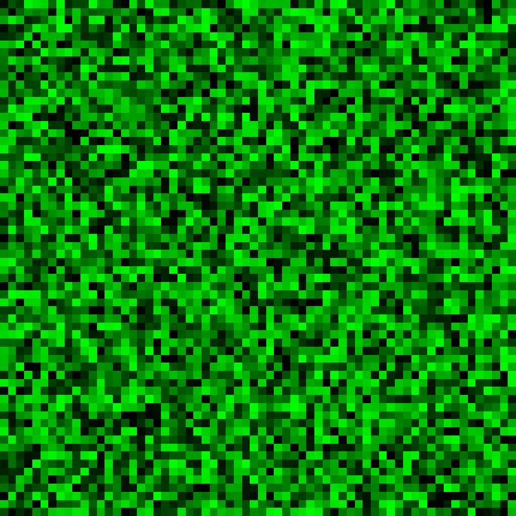
















Figure S3. Simulating dynamic near-field speckle patterns
a
$$Φ(x,y)$$
$$E_{0}\left(x,y\right)=\exp{[iΦ(x,y)]}$$
$$E_{1}\left(x,y\right)=E_{0}\left(x,y\right)⨂\left\{\frac{J_{1}\left(r/Δ_{g}\right)}{\left(r/Δ_{g}\right)}\right\}$$
Fully-developed speckle
$$⨂CSF\left(\frac{r}{Δ_{g}}\right)$$
A speckle pattern of the grain size $Δ_{g}$
$$−π$$
0
$$π$$
$$\exp{(−iπ)}$$
1
$$\exp{(iπ)}$$
b
$$Δ_{g}≈\frac{λ_{ex}}{2NA_{il}}$$
c
Far-field speckles
$$Φ_{1}$$
$$CSF\left(\frac{r}{Δ_{g}}\right)=\frac{J_{1}\left(r/Δ_{g}\right)}{\left(r/Δ_{g}\right)}$$
$$Φ_{2}$$
$$Φ_{3}$$
$$e^{iΦ_{n}}⨂CSF\left(\frac{r}{Δ_{g}}\right)$$
$$Δ_{g}≪\frac{λ_{ex}}{2NA_{il}}$$
Near-field speckles

Slide 20
a
$$Φ(x,y)$$
$$E_{0}\left(x,y\right)=\exp{[iΦ(x,y)]}$$
$$E_{1}\left(x,y\right)=E_{0}\left(x,y\right)⨂\left\{\frac{J_{1}\left(r/Δ_{g}\right)}{\left(r/Δ_{g}\right)}\right\}$$
Fully-developed speckle
$$⨂CSF\left(\frac{r}{Δ_{g}}\right)$$
A speckle pattern of the grain size $Δ_{g}$
$$−π$$
0
$$π$$
$$\exp{(−iπ)}$$
1
$$\exp{(iπ)}$$
b
$$Δ_{g}≈\frac{λ_{ex}}{2NA_{il}}$$
c
Far-field speckles
$$Φ_{1}$$
$$CSF\left(\frac{r}{Δ_{g}}\right)=\frac{J_{1}\left(r/Δ_{g}\right)}{\left(r/Δ_{g}\right)}$$
$$Φ_{2}$$
$$Φ_{3}$$
$$e^{iΦ_{n}}⨂CSF\left(\frac{r}{Δ_{g}}\right)$$
$$Δ_{g}≪\frac{λ_{ex}}{2NA_{il}}$$
Near-field speckles

Slide 21

























Figure S4. Workflow of NS-SOFI processing
$$NS(r,t_{1})$$
$$NS(r,t_{2})$$
$$NS(r,t_{3})$$
$$×O(r)$$
$$I_{mean}={\left\langle I\left(r,t\right)\right\rangle }_{t}$$
2nd NS-SOFI (FRW)
3rd NS-SOFI (FRW)
Fourier-reweighting
$$O(r)$$
$$I\left(r,t\right)=\{NS\left(r,t\right)⋅O(r)\}⨂PSF\left(r\right)$$
2nd NS-SOFI (dec)
3rd NS-SOFI (dec)
Intensity average
Lucy-Richardson deconvolution
SOFI processing
$$I(r,t_{1})$$
$$I(r,t_{2})$$
$$I(r,t_{3})$$
(with typ. 3,000 frames)
2nd NS-SOFI (raw)
3rd NS-SOFI (raw)

Slide 22
$$NS(r,t_{1})$$
$$NS(r,t_{2})$$
$$NS(r,t_{3})$$
$$×O(r)$$
$$I_{mean}={\left\langle I\left(r,t\right)\right\rangle }_{t}$$
2nd NS-SOFI (FRW)
3rd NS-SOFI (FRW)
Fourier-reweighting
$$O(r)$$
$$I\left(r,t\right)=\{NS\left(r,t\right)⋅O(r)\}⨂PSF\left(r\right)$$
2nd NS-SOFI (dec)
3rd NS-SOFI (dec)
Intensity average
Lucy-Richardson deconvolution
SOFI processing
$$I(r,t_{1})$$
$$I(r,t_{2})$$
$$I(r,t_{3})$$
(with typ. 3,000 frames)
2nd NS-SOFI (raw)
3rd NS-SOFI (raw)

